Slide 1

Chapter 6:: Control Flow
Programming Language Pragmatics
Michael L. Scott
Copyright © 2009 Elsevier

Slide 2
Control Flow
Basic paradigms for control flow:
  Sequencing
  Selection
  Iteration
  Procedural Abstraction
  Recursion
  Concurrency
  Exception Handling and Speculation
  Nondeterminacy
Copyright © 2009 Elsevier

Slide 3
Expression Evaluation
Infix, prefix operators
Precedence, associativity (see Figure 6.1)
  C has 15 levels - too many to remember
  Pascal has 3 levels - too few for good semantics
  Fortran has 8
  Ada has 6
    Ada puts and & or at same level
  Lesson: when unsure, use parentheses!
Copyright © 2009 Elsevier

Slide 4
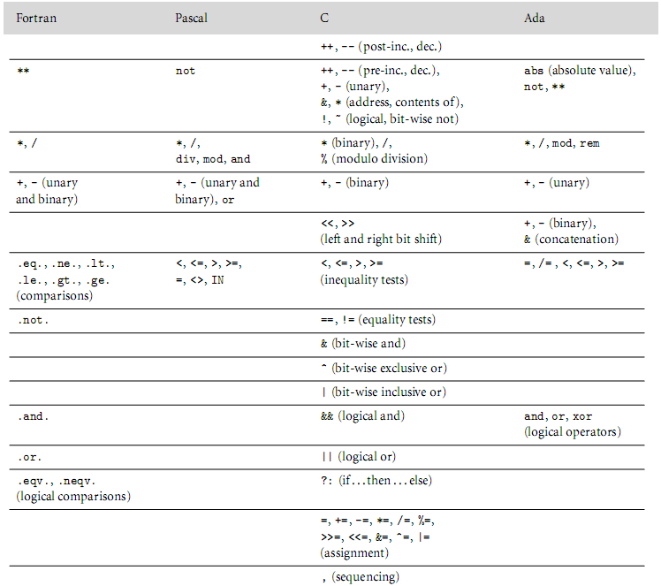
Expression Evaluation
Figure 6.1 Operator precedence levels in Fortran, Pascal, C, and Ada. The operator s at the top of the ﬁgure group most tightly.
Copyright © 2009 Elsevier

Slide 5
Expression Evaluation
Ordering of operand evaluation (generally none)
Application of arithmetic identities
  distinguish between commutativity, and (assumed to be safe)
  associativity (known to be dangerous)
  (a + b) + c works if a~=maxint and b~=minint and c<0
  a + (b + c) does not
  inviolability of parentheses
Copyright © 2009 Elsevier

Slide 6
Expression Evaluation
Short-circuiting
  Consider (a < b) && (b < c):
    If a >= b there is no point evaluating whether b < c because (a < b) && (b < c) is automatically false
  Other similar situations
if (b != 0 && a/b == c) ...
if (*p && p->foo) ...
if (f || messy()) ...
Copyright © 2009 Elsevier

Slide 7
Expression Evaluation
Variables as values vs. variables as references
  value-oriented languages
    C, Pascal, Ada
  reference-oriented languages
    most functional languages (Lisp, Scheme, ML)
    Clu, Smalltalk
  Algol-68 kinda halfway in-between
  Java deliberately in-between
    built-in types are values
    user-defined types are objects - references
Copyright © 2009 Elsevier

Slide 8
Expression Evaluation
Expression-oriented vs. statement-oriented languages
  expression-oriented:
    functional languages (Lisp, Scheme, ML)
    Algol-68
  statement-oriented:
    most imperative languages
  C kinda halfway in-between (distinguishes)
    allows expression to appear instead of statement
Copyright © 2009 Elsevier

Slide 9
Expression Evaluation
Orthogonality
  Features that can be used in any combination
    Meaning is consistent
  if (if b != 0 then a/b == c else false) then ...
  if (if f then true else messy()) then ...
Initialization
  Pascal has no initialization facility (assign)
Aggregates
  Compile-time constant values of user-defined composite types
Copyright © 2009 Elsevier

Slide 10
Expression Evaluation
Assignment
  statement (or expression) executed for its side effect
  assignment operators (+=, -=, etc)
    handy
    avoid redundant work (or need for optimization)
    perform side effects exactly once
  C --, ++
    postfix form
Copyright © 2009 Elsevier

Slide 11
Expression Evaluation
Side Effects
  often discussed in the context of functions
  a side effect is some permanent state change caused by execution of function
    some noticable effect of call other than return value
    in a more general sense, assignment statements provide the ultimate example of side effects
      they change the value of a variable
Copyright © 2009 Elsevier

Slide 12
Expression Evaluation
SIDE EFFECTS ARE FUNDAMENTAL TO THE WHOLE VON NEUMANN MODEL OF COMPUTING
In (pure) functional, logic, and dataflow languages, there are no such changes
  These languages are called SINGLE-ASSIGNMENT languages
Copyright © 2009 Elsevier

Slide 13
Expression Evaluation
Several languages outlaw side effects for functions
  easier to prove things about programs
  closer to Mathematical intuition
  easier to optimize
  (often) easier to understand
But side effects can be nice
  consider rand()
Copyright © 2009 Elsevier

Slide 14
Expression Evaluation
Side effects are a particular problem if they affect state used in other parts of the expression in which a function call appears
  It's nice not to specify an order, because it makes it easier to optimize
  Fortran says it's OK to have side effects
    they aren't allowed to change other parts of the expression containing the function call
    Unfortunately, compilers can't check this completely, and most don't at all
Copyright © 2009 Elsevier

Slide 15
Sequencing
Sequencing
  specifies a linear ordering on statements
    one statement follows another
  very imperative, Von-Neuman
Copyright © 2009 Elsevier

Slide 16
Selection
Selection
  sequential if statements
  if ... then ... else
  if ... then ... elsif ... else
  (cond
  (C1) (E1)
  (C2) (E2)
  ...
  (Cn) (En)
  (T) (Et)
  )
Copyright © 2009 Elsevier

Slide 17
Selection
Selection
  Fortran computed gotos
  jump code
    for selection and logically-controlled loops
    no point in computing a Boolean value into a register, then testing it
    instead of passing register containing Boolean out of expression as a synthesized attribute, pass inherited attributes INTO expression indicating where to jump to if true, and where to jump to if false
Copyright © 2009 Elsevier

Slide 18
Selection
Jump is especially useful in the presence of short-circuiting
Example (section 6.4.1 of book):
  if ((A > B) and (C > D)) or (E <> F) then
  then_clause
  else
  else_clause
Copyright © 2009 Elsevier

Slide 19
Selection
Code generated w/o short-circuiting (Pascal)
r1 := A -- load
r2 := B
r1 := r1 > r2
r2 := C
r3 := D
r2 := r2 > r3
r1 := r1 & r2
r2 := E
r3 := F
r2 := r2 $<>$ r3
r1 := r1 $|$ r2
if r1 = 0 goto L2
L1: then_clause -- label not actually used
goto L3
L2: else_clause
L3:
Copyright © 2009 Elsevier

Slide 20
Selection
Code generated w/ short-circuiting (C)
r1 := A
r2 := B
if r1 <= r2 goto L4
r1 := C
r2 := D
if r1 > r2 goto L1
L4: r1 := E
r2 := F
if r1 = r2 goto L2
L1: then_clause
goto L3
L2: else_clause
L3:
Copyright © 2009 Elsevier

Slide 21
Iteration
Enumeration-controlled
  Pascal or Fortran-style for loops
    scope of control variable
    changes to bounds within loop
    changes to loop variable within loop
    value after the loop
Copyright © 2009 Elsevier

Slide 22
Recursion
Recursion
  equally powerful to iteration
  mechanical transformations back and forth
  often more intuitive (sometimes less)
  naïve implementation less efficient
    no special syntax required
    fundamental to functional languages like Scheme
Copyright © 2009 Elsevier

Slide 23
Recursion
Tail recursion
  No computation follows recursive call
  int gcd (int a, int b) {
  /* assume a, b > 0 */
  if (a == b) return a;
  else if (a > b) return gcd (a - b,b);
  else return gcd (a, b – a);
  }
Copyright © 2009 Elsevier

